Slide 1
Gun Detection
Mikołaj Karapka, Rafał Leja

Slide 2
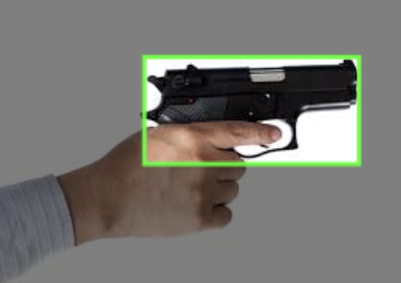
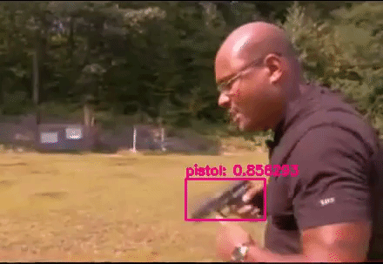
Problem Definition
Real-time detection of guns from CCTV footage

Slide 3
Business Justification
CCTV is widely available, but human capacity to detect danger is limited, often resulting delayed response. In situations as armed robbery or active shooter incidents, we need to react as quick as possible,
Automatic gun detection could be used as a real-time warning system to instantly alert security personnel and significantly reduce response time.

Slide 4
Datasets
We consider following datasets:
Pistols Dataset:
2986 images of pistols
Only pistol annotation class
Gun Detection:
1000 images of different guns
Only gun annotation class
All datasets contain various photos showing guns from different perspective

Slide 5
Feasibility
Object detection of a visually distinct object (gun) is a well-solved problem class
Modern detectors like YOLO can learn it efficiently
Transfer learning removes the need for massive datasets

Slide 6
Proposed approach
We will try to build two computer-vision models that accurately detect in real-time CCTV footage
1st approach:
Fine-tuned pre-trained model e.g. YOLO rf detr
Goal: Very high accuracy and inference efficiency
2nd approach:
Model trained from scratch
Goal: Data efficiency

Slide 7
Proposed approach
Methods that we will use:
Negative samples
Data augmentation

